Slide 1
Religious Freedom: Historical Perspectives
Gary B. Doxey
International Center for Law and Religion Studies at BYU
June 23, 2011

Slide 2
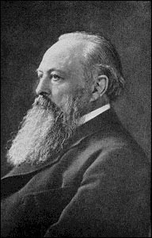
Lord Acton, 1834-1902
[F]ree government . . . can only be the fruit of long, manifold, and painful experience.
Power tends to corrupt, and absolute power corrupts absolutely. Great men are almost always bad men.
Notes:
Lord Acton—one of the most well-read historians ever, but he wrote little. Aspired to find the roots of freedom, which he located in the classical past of Greece and Rome. A Whig and a Catholic—with an agenda.
Having an agenda is one of the difficulties with writing the history of Religious Freedom, a story that hasn’t really yet been told in a competent, comprehensive way.
Religious history, history of persecution, history of ideas—all subject to bias. Since Eusebius wrote his Ecclesiastical History in the 4th century A.D., religious scholars who turn to history have invariably tried to use it to prove the validity of their own beliefs over those of rivals. Protestant histories of the Reformation are very different from Catholic ones, for example.
Legal and constitutional history—not often informed by context, focus on words in a document.
Social history—history of tolerance, all about context, not always appreciative of ideas.
Nearly all are heavily Eurocentric, partake of myth as much as well as fact.

Slide 3
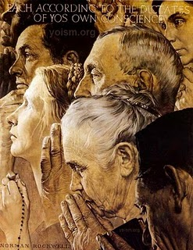
What is Religious Freedom?
Notes:
The philosophical dimension of religious freedom adds to the difficulty of understanding the history of religious freedom. What is religious freedom? Is it positive or negative? That is, is it the absence of something, like persecution or prejudice? Or is it the presence of something, like loyalty to a shared value of respect for the beliefs of others? Is religious freedom the same as religious tolerance? Does it require a written law, or simply certain attitudes and actions? Does it depend on an agreed philosophy about what it means or what is its ultimate origin? Such questions are not our subject today, but they underscore the conceptual difficulty of understanding the history of religious freedom.

Slide 4
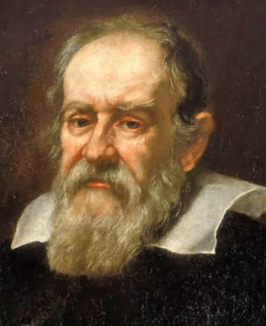
Tension between Competing Ideas
A dynamic of history since ancient times.
Often in the form of old versus new ideas.
Tension greatest when ideas challenge authority.
E.g., Galileo Galilei, 1564-1642.
Notes:
What gives rise to religious freedom or the desire for it? Tension. Ideas are extraordinarily powerful things. Tension resulting from competing ideas is the milieu out of which religious freedom has grown.
Reiterating what Lord Acton said: “[F]ree government . . . can only be the fruit of long, manifold, and painful experience.”
Tension between competing ideas has been a dynamic of history since ancient times. It often takes the form of old versus new ideas. The tension is greatest when ideas challenge authority.
The level of fear and concern new ideas can produce in those loyal to old ideas can seem incomprehensible when removed from their cultural context. For example, in this day and age we struggle to understand why the Roman Inquisition condemned Galileo Galilei (1564-1642), forced him to recant, and held him under house arrest for the latter part of his life because of his belief that the earth orbits around the sun and not the other way round. In Galileo’s time and context, these ideas were the cause of grave concern because they contradicted the official view of the universe propounded by established religious authority.
Throughout most of history, governments have demanded loyalty to a particular religion and have equated it with loyalty to the regime. Consequently, failure to be loyal to the official religion has often been treated as disloyalty to the government, a crime tantamount to treason. This sentiment has been one of the key motivations for religious persecution on an official level. It has justified numerous wars, purges, and ethnic cleansings.

Slide 5
Quick Personal Observations
Religious freedom is a very rare thing in human history.
Its price has usually been very high.
Notes:
Now before we launch into the story of the rise of religious freedom, I’ll briefly share a few personal insights and patterns I’ve observed about religious freedom in history.
First two insights: (1) Religious freedom is a very rare thing in human history, and (2) the price of religious freedom has usually been very high in terms of effort and lives.

Slide 6
Religious Freedom in History: Four Patterns of Evolution
Conversion of a ruler who proclaims freedom of belief and practice for the new religion – often replaced in the next generation by intolerance for the old religion.
Religious conflict (really exhaustion from conflict) leading to a modus vivendi of some tolerance.
Introduction of new ideas through trade, proselytism, conquest, or immigration, resulting in attitudes of pluralism.
Intellectual and political commitment to freedom.
Notes:
Now I offer four patterns I have observed about when religious freedom arises.
Conversion of a ruler who proclaims freedom of belief and practice for the new religion – often replaced in the next generation by intolerance for the old religion. The examples here include Constantine’s conversion to Christianity in 312 AD. The Icelandic Allthing in 1000 voted to follow Christianity and actually legislated in tolerance for paganism for one more generation and intolerance thereafter.
Religious conflict (really exhaustion from conflict) leading to a modus vivendi of some tolerance. The example is Reformation Europe at the end of the religious wars.
Introduction of new ideas through trade, proselytism, conquest, or immigration, resulting in attitudes of pluralism. This describes somewhat the Roman Empire during the Pax Romana and more particularly the English colonies of North America, where immigration and revivalism led to religionists of many stripes living as neighbors.
Intellectual and political commitment to freedom. This is of course the United States in the revolutionary period and since then many other countries.

Slide 7
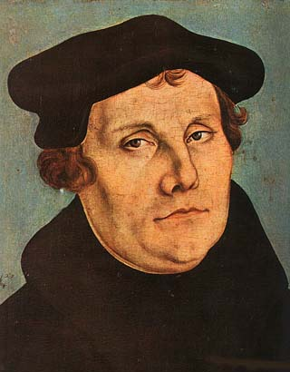
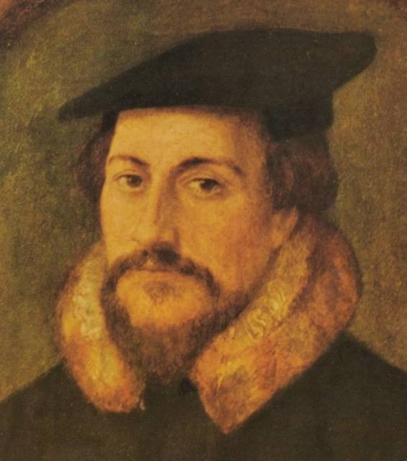
The Traditional Narrative of Freedom: The Reformation
Luther Calvin
Notes:
Modern religious freedom is the product of a long, heroic, and blood-stained evolution. Where to start in explaining how this happened? Personally, I would like to take you back to Cyrus the Great and Ashoka, the greatest ruler of ancient India, to pluralistic classical Rome and the competition between church and kings of the Middle Ages, to the Gregorian Reforms of the 11th century and to the liberation theology of the Crusades, to the Cathars of southern France whom crusading armies annihilated because of their distinct beliefs, to martyrs of conscience like John Wycliffe and Jan Hus, and to the expulsion of Jews from many lands. These are all important and some of them are neglected parts of the history of religious freedom.
However, to keep this simple, I’ll start the narrative of the rise of religious freedom where most European and American commentators do—with the Reformation.
[click]
According to the traditional American narrative of the history of religious freedom, the kernel of modern religious liberty began to take recognizable shape in Reformation Europe. Courageous thinkers and people of faith rejected the mandatory creeds of a corrupt Christian hierarchy, began to diversify and multiply in their doctrinal variations, and pointed the way toward modern pluralism.
[Could expound more on heresy and heretics in earlier periods.]
For centuries prior to the Reformation, Christians who had insisted on religious views different from those of the ruler were considered traitors and a danger to social order who should be tried and executed. It was no different with the advent of the Reformation. It was simply that now vast numbers of adherents to new religious ideas were considered to be in a state of rebellion to their rulers.

Slide 8
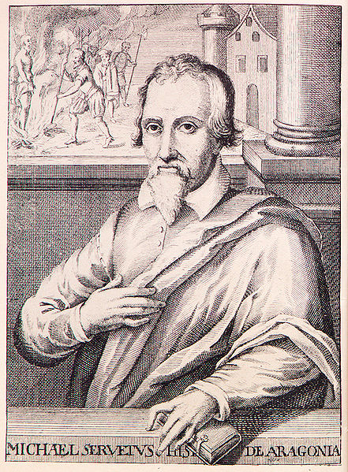
Miquel Servet, 1511-1553
Notes:
Just a pause to insert a notorious example of a someone who was burned at the stake for having unusual beliefs because he was considered a danger to the well-being of the state: Miquel Servet, also known by his Latin name Servetus, was a Catalan polymath whose learning and scientific writings were widely admired. Among his other accomplishments, he was the first to explain in detail the pulmonary system; but his knowledge extended to many other fields—a true Renaissance man.
He was religiously fervent and sincere. However, as part of his theological musings, he came to the conclusion that the Trinity described in the Nicene Creed was an invention of post-biblical origin and not consistent with scripture. Many regard his beliefs as an early form of Unitarianism. Needless to say, he found himself at odds with both Catholics and Protestants. He was hunted from place to place by the Inquisition. After living for some time in southern France under a false identity, he was discovered and imprisoned by order of the Inquisition. With the aid of friends, he escaped and fled toward Italy. But he was apprehended en route in Switzerland and burned at the stake outside the walls of Geneva in 1553 by order of John Calvin. His public execution was witnessed by multitudes and caused a stir among many intellectuals.

Slide 9
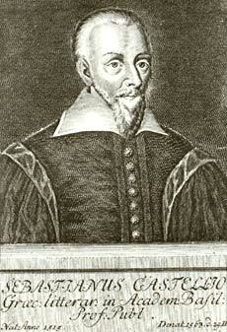
Sebastian Castellio, 1515-1563
His ideas on tolerance resonate positively today
“To kill a man is not to protect a doctrine, but it is to kill a man.”
Notes:
Sebastian Castellio was perhaps the most eloquent of those who reacted negatively to Servet’s death. He was a teacher and had been a Reformed Protestant preacher. He was once a friend of Calvin’s but later fell out with him. He had long been troubled by the severity of the punishments meted out to supposed heretics.
Castellio’s writings in reaction to Servet’s execution gained some notoriety. He was one of the first thinkers to advocate limited government and separation of church and state. He was admired by Voltaire and Montaigne. His treatise on tolerance resonates positively today. He was far ahead of his time, which is perhaps why he had little practical influence during his lifetime.
His most famous quote is: “To kill a man is not to protect a doctrine, but it is to kill a man.”

Slide 10
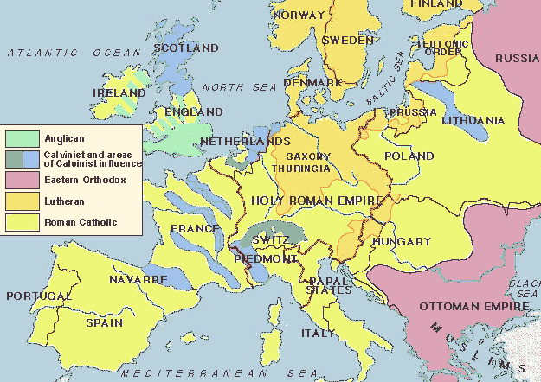
The Division of Christendom
Notes:
Religious conflict spread throughout western Europe. Doctrinal differences extant in European principalities underscored political differences. Rulers all through Germany and the Low Countries who chafed at Roman or imperial rule welcomed a theology that subordinated the church to the state. Henry VIII in England shared that motivation, though his theology remained strikingly Catholic for one so willing to rebel against Rome. The point is that from the beginning of the Reformation, the conflict was not merely a question of true doctrine versus heresy. It was perhaps even more a matter of politics. The desire for political independence and freedom from unwanted foreign rule was closely linked to the desire to be free to believe new religious doctrines.

Slide 11
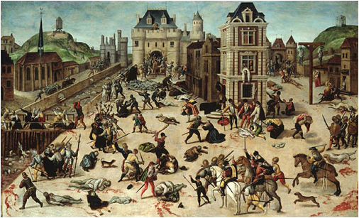
1530-1648—A Century of War
Notes:
Almost from the beginning of the Reformation, Catholics and Protestants, backed by self-interested rulers as well as pious ones, marshaled themselves against each other in prolonged wars of attrition. Lasting more than a century, these wars were one of the great calamities of all time. Though this century enjoyed periods of peace, underlying tensions boiled to the surface numerous times.
Pictured on this slide is a painting of the St. Bartholomew’s Day Massacre in 1572, one of the most notorious purges of French Huguenots. On the eve of what was to be a formal reconciliation between the French royal family and the leading Huguenot nobility, mobs rose up across France and put many thousands of their Huguenot neighbors to death, dragging them from their homes into the streets and murdering them in intentionally sadistic ways.

Slide 12
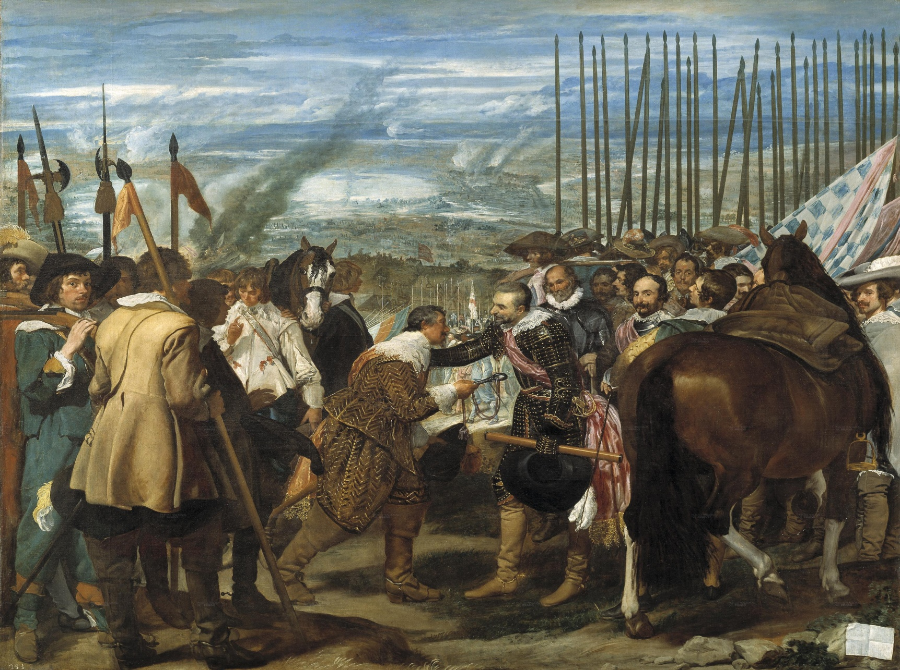
Notes:
Exhausted by the costly religious wars and persecutions of the 16th and 17th centuries, European rulers finally had to face up to the fact that not all would share a single belief. A détente-like form of religious tolerance seemed the only practical way forward. This practical tolerance should not be confused with intellectual respect for multiple beliefs. Much prejudice continued, but the people were finally getting tired of the violence.
One of the main solutions leaders resorted to was to divide up territories between Catholic and Protestant regions and expel the remaining members of the minority religion to more friendly regions. This was how, for example, the Netherlands was reconfigured. The southwestern provinces that Spain controlled eventually became almost totally Catholic (the future Belgium) and the northeastern ones became officially Reformed (the country of the Netherlands). At the start of the conflict, Catholics and Protestants were spread throughout the region. By the end, they were segregated both religiously and politically.
The painting on the slide is “Las Lanzas,” or “The Surrender of Breda,” by Velazquez, depicting the Protestant Dutch forces of Orange conceding the territory of Breda to the Catholic Spanish.

Slide 13
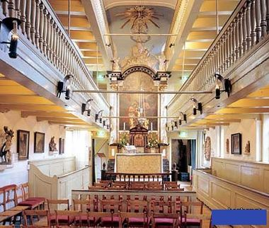
Schuilkerk or “Hidden Church”
Notes:
Not all people separated into neat political pockets adhering to the same faith. Common people thrust into close contact with people of differing faiths in cosmopolitan Holland began to find practical accommodations in their daily interactions with each other that allowed them to tolerate if not respect one another. Pictured here is an example of schuilkerk, a clandestine or hidden church. This is a Catholic church located on the top three floors of a canal house built in the heart of the Reformed Protestant city of Amsterdam, where Catholic churches were illegal. The outside looks like a normal building, but the inside is clearly a church replete with prohibited images of Catholic saints. The neighbors and the authorities were aware of the church and of the comings and goings of the parishioners, but they allowed the fiction that the church didn’t really exist because it didn’t invade the Protestant solidarity of the community space. It was a shared secret and evidence that practical attitudes of tolerance sometimes ran ahead of official laws to the contrary.

Slide 14
Treaties: the original Western European form of religious freedom law
Peace of Augsburg (1555)
Union of Utrecht (1579)
Peace of Westphalia (1648)
Notes:
At the same time as practical accommodations of divergent beliefs began to crop up among the people, legal principles enshrining a degree of toleration appeared in the treaties that ended the religious wars. These treaties are among the earliest legal documents that acknowledge something resembling religious freedom in Western Europe.

Slide 15
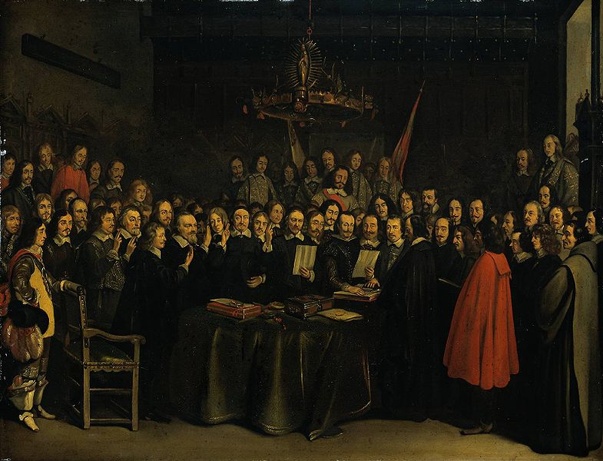
Peace of Westphalia, 1648
Notes:
The most celebrated of these treaties is the Peace of Westphalia in 1648, which ended the devastating Thirty Years War. It was actually a group of treaties negotiated among the competing princes of the dominions that had mostly been a part of the Holy Roman Empire.

Slide 16
The Rule
Cuius regio, eius religio
Whose region, his religion
Notes:
The Peace of Westphalia signaled the triumph of temporal authority over church rule by allowing rulers to select the religion that would be followed in their own realm, whether Catholic, Protestant, Reformed Protestant, or a combination, and allow the populous to decide for themselves whether to live under that regime or move to another principality.
The rule became known as cuius regio, eius religio (“whose region, his religion”).
Though far from true religious freedom, it was a solid step away from the thousand-year-old European belief that political solidarity required uniformity of Christian doctrine and an important step toward recognizing the political legitimacy of differing views.
Not surprisingly, many historians view these treaties, and particularly the Peace of Westphalia, as a clear break with the medieval past and the beginning of the modern era.

Slide 17
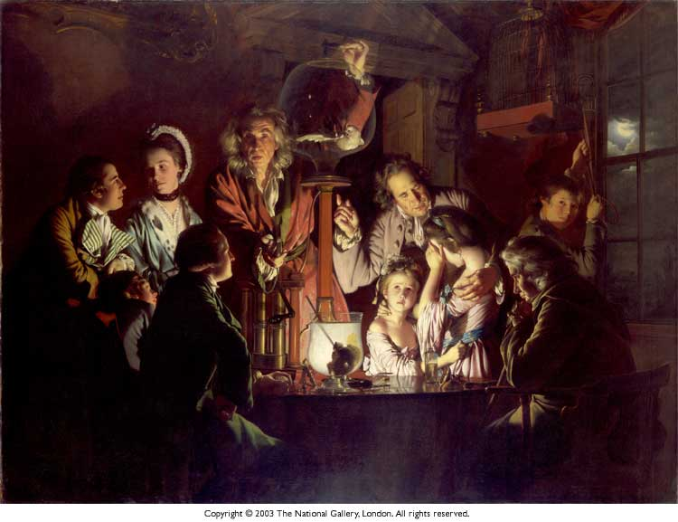
The Age of Enlightenment
Notes:
Conventional history calls the 18th century the “Age of Enlightenment.” It was a time of advances in science and philosophy that still reverberate today.
The nature, extent, and impact of this Enlightenment has been the subject of much debate among historians in recent decades however. This is in part because traditional intellectual history, the history of ideas, is currently out of fashion; historians have migrated to new unplowed fields of social history with its focus on the experience of common folk. Study of the Enlightenment is too Eurocentric and elitist for some tastes. It is often maligned as being no more than the genealogy of ideas—ideas that were out of touch with the plight of most people.
One of the prevailing criticisms is that the notion of Enlightenment was something of a pretension that Enlightenment scholars themselves fostered. They saw themselves as superior to previous thinkers. Modern critics question whether the traditional narrative of the Enlightenment is a modern construct that ignores contradictory evidence. They are quick to point out that the ideas of intellectual elites of the 18th century had relatively little currency beyond a small circle of people whose direct influence on the great masses of people was quite limited. Critics also attack the presumption of forward progress inherent in the name “Enlightenment.” The assumption of progress is easily countered by the many atrocities humans perpetrated against one another both during and after this supposed enlightened age.
Regardless of these criticisms, in my mind there is one salient point that should not be lost in the debate: It is clearly evident that the Enlightenment generations were full of unusual optimism and creative vision. This optimism, whether considered the product of delusional self-admiration or authentic selfless ideal, led to an age of remarkable and revolutionary change.

Slide 18
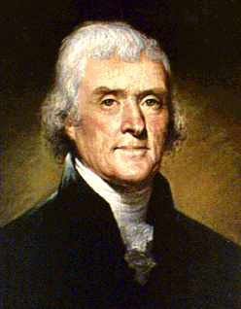
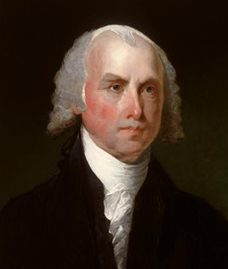
The Enlightenment and Revolution
Locke Jefferson Madison
Notes:
With regard to religious freedom, the idea of tolerance gained momentum, wider acceptance, and an intellectual voice during the Age of Enlightenment. Perhaps most notably, John Locke’s writings on toleration pointed out that society would become more stable if government respected diverse beliefs rather than suppressed them in favor of a single unified official religion.
Though these ideas were largely ignored by European despots, they took root in the fertile soil of the English colonies of the New World. These ideas certainly influenced in profound ways the late-colonial elites of America, such as Thomas Jefferson and James Madison.

Slide 19
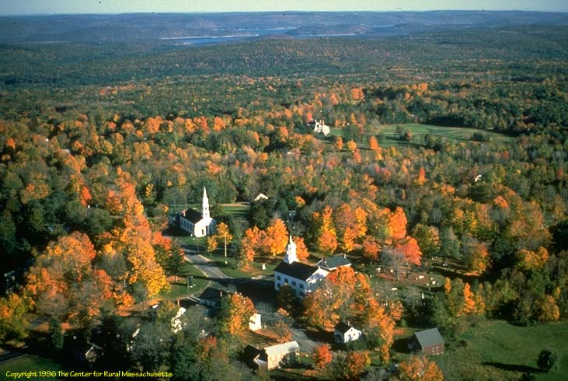
Colonial American Pluralism
Notes:
Of more practical significance, perhaps, was the impact of living conditions in America on a much wider group of Americans than just the elites. America was a most remarkable corner of the world in the 18th century, unlike any country in Europe. It was home to a population whose diversity of belief was unprecedented in history.

Slide 20
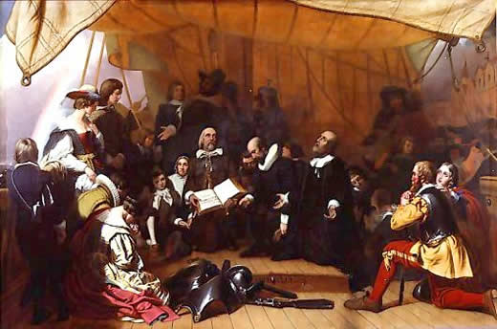
Notes:
Many early settlers had actually come to America as refugees fleeing religious persecution. Puritans went to New England. Catholics sought haven in Maryland. Pennsylvania was for the Quakers and later the German Mennonites. Georgia welcomed dissenters of many types, including Jews. Rhode Island was settled by dissenters from Massachusetts. New York, Delware, and New Jersey, too diverse to identify with one group or another, became havens of pluralism.
To be sure, many settlers in colonial America had other motives for coming to this land, but there is no doubt that the memory of religious persecution factored into the collective conscience of Americans. Whether fact or fiction, today we still nourish the image of our colonial forefathers as arriving on America’s shores to escape religious persecution. The idea that they were seeking and were here able to find religious freedom is a part of American mythology.

Slide 21
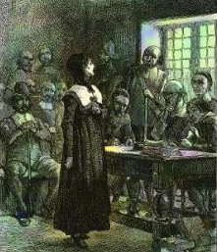
Old Prejudices Slow to Give Way
Anne Hutchinson on Trial
Notes:
The early colonial experience demonstrated that colonial government was not particularly tolerant of independents and separatists. Old prejudices were slow to give way. Governments in New England were at first very unfriendly toward Quakers and independent religious thinkers like Roger Williams and Anne Hutchinson. In many parts of the colonies, Catholics were suspected of being part of a great papal cabal conspiring to take over free English government. Anglicans in Virginia persecuted the minority Baptists.

Slide 22
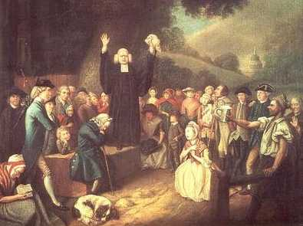
Notes:
But things changed dramatically overtime. By virtue of demography, geography, economic opportunity, and other practical realities, colonial America became a land of de facto religious pluralism even before religious freedom became the law.
One part of the equation was the impact of revivalism in the Great Awakening. Itinerant preachers called the people to camp meetings and elicited emotional experiences with religion that were less about specific established churches and more about personal status before God. One of the reasons they were itinerants is that the established churches did not allow them to preach. In fact, local laws outlawed itinerant preaching in many cases for the very purpose of suppressing new doctrines and methods.
Baptists and Methodists, who were very much in the minority in the beginning, began to gain ground. Soon vast numbers of otherwise unchurched Americans were enthusiastically embracing a personal Christian religion—but not religion of the established Church of England or Congregational variety. The Great Awakening brought a heightened sense that man could and should rebel against unjust established authority and stand independent in his own convictions. Many scholars view its influence as foundational to the later American bid for independence from Britain.
This is a painting of George Whitefield, an enormously important itinerant preacher and one of the founding fathers of Methodism in America.

Slide 23
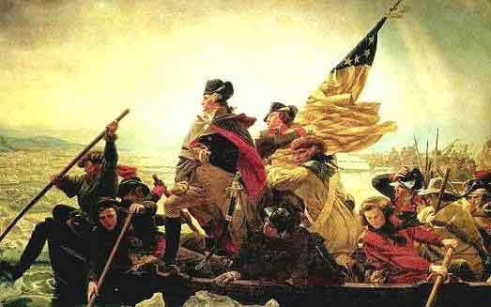
A Revolutionary Break
Notes:
The majority of Americans at the time of the Revolution were religiously fervent but not church-goers. Only one in eight was formally a member of a church. Adherents to diverse minority faiths, whose numbers were fueled by immigration and revival, outnumbered in the aggregate the members of traditional established churches.
Degrees of religious establishment existed in various forms in some of the colonies and even after independence in a few of the states. However, the trajectory and momentum of the American condition worked forcefully in a different direction. The Great Awakening, the unprecedented religious diversity of the American populous, the distance and spread of settlement, the ready ability of Americans to pull up stakes and move to new communities, and the weakness and distance of formal ecclesiastical authority deflated any attempt to unify Americans under established religion. The influence of Enlightenment thought on late-colonial elites proved compelling to the discussion of new forms of government and the possibility of independence. All of these influences, and not least the War of Independence itself, engendered an irreversible break with the European past and the emergence of a new American ideal of freedom.

Slide 24
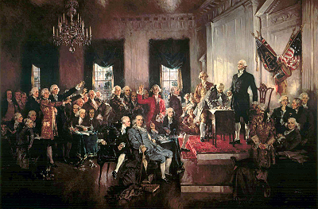
Notes:
The culminating chapter of the American religious freedom narrative is that religious freedom was formulated into a firm legal concept in revolutionary America.
The War for Independence cut short any possibility that a European-style established church would gain traction among Americans. Through the wisdom and advocacy of enlightened founders such as Madison and Jefferson, freedom of religion became part of our constitutional heritage in the First Amendment with its two clauses, the prohibition against established churches and freedom to exercise one’s faith unmolested by government.

Slide 25
Since the Constitution
Notes:
This is not the time to discuss in detail the complicated constitutional, legal, and social history of religious freedom in America since the Constitution. That is a complicated subject that feeds many lawyers and their families and fills volumes of interesting materials.
I do wish to say, however, that since their promulgation in the United States Constitution, ideas about religious freedom have spread throughout the world. Religious freedom has now become one of the United States’ most important intellectual exports. It is part of the fabric of international human rights instruments and many of the world’s constitutions, though with varying degrees of adherence to original concepts. This is not to say that modern religious freedom is wholly American in origin or application.

Slide 26
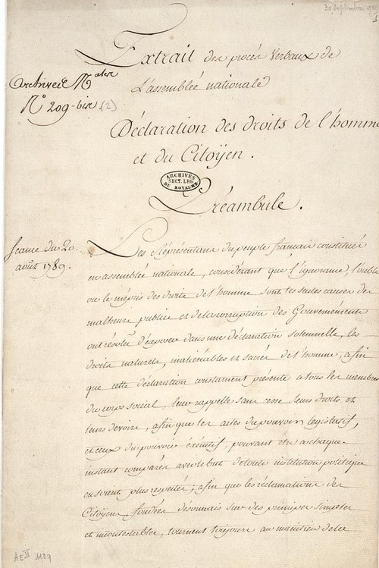
Declaration of the Rights of Man, 1789
“No one shall be disquieted on account of his opinions, including his religious views, provided their manifestation does not disturb the public order established by law.”
Notes:
Ideas of liberty from revolutionary France (which is in many respects the United States’ sister democracy) deserve significant comment in the spread of religious freedom. The French Revolution in 1789 produced an important document, the Declaration of the Rights of Man. Article 10 of that document states:
“No one shall be disquieted on account of his opinions, including his religious views, provided their manifestation does not disturb the public order established by law.”
Certainly, the French Revolution is seen by most European nations as well as their former colonial territories as THE revolution, the one that changed the Ancien Regime, the old order of things, and brought power to the people. For all of the growing pains and horrors the French people experienced in the aftermath of revolution, they have become the city on a hill to several other nations on questions of “liberty, equality, and fraternity.”
Religious freedom has taken a more separatist and secular route in the French tradition than in the U.S. Whereas, the United States emerged out of a reality of religious pluralism, the French Revolution reacted vehemently against the dominance of a single religion. Freedom of belief has therefore been considered at various stages of French history to be much more a private matter. The revolution marked a divorce between church and state, not their mutual peaceful coexistence. Thus, today the U.S. view of religion in the public square generally has a much more accommodating feel than in France, where to have a motto like “In God We Trust” would be unthinkable.

Slide 27
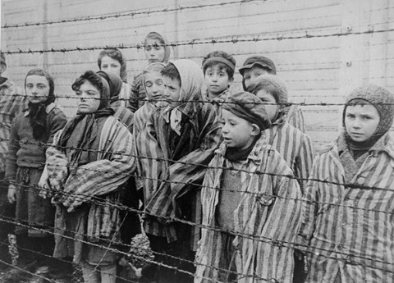
Modern International Human Rights
Notes:
A post-World War II addendum must be added to the story of religious freedom. As nations emerged from the devastating conflict of World War II and sought legal structures for peaceful coexistence, human rights became a vital topic. The theoretical justification for human rights at that time coalesced around the idea of human dignity, which, not coincidentally, was the ideological opposite of the defeated Nazis’ belief in the superiority of the German race and the animal-like status of Jews, Romas, and others.

Slide 28
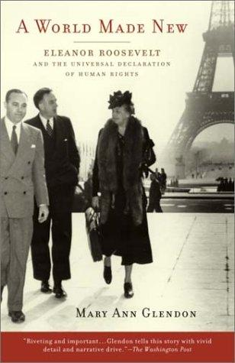
The Universal Declaration of Human Rights, 1948

Slide 29
Toward a Competent History of Religious Freedom
Elements of “myth,” in a positive sense, are in the historical narrative
Careful and thoughtful, more nuanced study and analysis are needed
The need for appreciation and understanding of religious freedom is great “Lest we forget.”
Notes:
The story of the historical rise of religious freedom is fascinating and inspiring. In fact, it partakes of the elements of myth, by which I mean not something that is false but a “mythos” in the Greek sense, meaning an explanatory story of origin. It is a story of the origin of freedom that helps us conjure and articulate our national ethos. It helps us identify who we are as a nation. It helps our concept of religious freedom hold together.
As I said, I do not criticize this “mythos” as false. On the contrary, I, too, am inspired by it and aspire to preserve our freedoms when I reflect on it. The horrific price paid for our freedom was real. The heroes of the story are truly remarkable. The freedom engendered by their work was revolutionary and unknown in any preceding era.
But while the customary narrative is not false, it is not exactly nuanced either—nor is it complete. To illustrate, the adoption of the First Amendment did not put to rest debate about the meaning and application of religious freedom in American life, to say the very least. That is another story, one that is very complicated and about which there is more vociferous disagreement today than perhaps ever before in our nation’s history.
My caution is that to truly understand the story of religious freedom we have to go deeper. We have to understand more fully the political and social context of what happened. We have to review common interpretations for accuracy and detail. For instance, we cannot accept at face value the idea that the Reformation brought about religious toleration, for the direct result was really quite the opposite—it ushered in war and destruction on a scale unknown in history. What the Reformation did, rather, was to tee up a question about religious toleration that society was eventually compelled to answer. Another example is that we have to consider more fully the Catholic view of the Reformation. A brief review of historical accounts of this period from Mediterranean Europe compared with those from northern Europe reveals a clear cultural bias and widely divergent interpretations, almost as if modern historians of differing religious persuasions are still at war with each other in print.
Nor can we take as factual, to cite another example, the traditional assessment that religious wars ended with the Peace of Westphalia or that Enlightenment ideals about religious toleration gained wide currency. While a small number of intellectual elites may have held high-minded notions of tolerance, the fact is that many Europeans and even Americans still didn’t “get it” and continued to hate and persecute each other over matters of belief. Indeed, some of the most horrific violence and persecution in the name of religion have taken place since the Enlightenment. Several examples can be named from the 18th and 19th centuries. Some of the worst are from our own time. Mentally, we might discount these events as aberrations outside the norm of western experience, but the Holocaust, Kosovo, and similar examples of violence tainted with religious prejudice should remind us that we have not advanced so far.
The need for appreciation and understanding of religious freedom is great “Lest we forget.”
ON BEING HUMBLE AND TRUE AS A HISTORIAN
History is the pursuit of the past, not the past itself. It is an individual appreciation of human experience. Historians approach their study from many perspectives and with a variety of beliefs, biases, and purposes. Some are artists in their approach, some are storytellers, some are poets, some are philosophers, some are psychologists, some are social scientists. They can be impressionists or realists, traditionalists or innovators, optimists or pessimists. They might investigate a small detail or they might try to capture the grand view. They might advocate, or they might merely observe. Their work might be guided more by emotion than precision, more by belief than cold “fact.” Moreover, they might exhibit any or all of these attributes and tendencies at a given time. The variety of history has no bound.
The point is that each and every historian is tied to moorings of some sort, be they cultural, ideological, or simply a matter of individual preference and personality. Good historians realize this; they recognize their limitations and those of their sources. Bad historians do not. They are tendentious, even arrogant, often trying to “prove” something or other without acknowledging the imprecision of their craft.
These statements, of course, reflect my own perception and bias. While I am at it, here are a few more of my personal views. Every historian is in some way engaged in a quest for truth. This may not be a quest for truth at a cosmic level, but it is at least at the level of trying to be accurate in research and analysis. That there is such a thing as truth I am convinced. That humans are capable of capturing, comprehending, and interpreting it without compromising it or changing it depends on their individual natures:
For intelligence cleaveth unto intelligence; wisdom receiveth wisdom; truth embraceth truth; virtue loveth virtue; light cleaveth unto light . . . (D&C 88:40).
To the extent men and women give heed to the great compass, the Holy Ghost, that teaches and confirms all truth, they allow their natures to be shaped by truth. They are led by degrees according to their humility, worthiness, and faith to the Source of all truth. This principle applies to the discipline of history as much as it does to any other discipline or aspect of human endeavor. As truth is one, so the quest for truth follows a single, universal path, regardless of the varied experience and capacity of those who follow that path. “The glory of God is intelligence,” our university motto proclaims. I hasten to complete the phrase, “or, in other words, light and truth.” (D&C 93:36.) It is not I.Q. that matters, but ability to seek, recognize, accept, and above all be faithful to light and truth.
[A]nd whatsoever is truth is light, and whatsoever is light is Spirit, even the Spirit of Jesus Christ. And the Spirit giveth light to every man that cometh into the world; and the Spirit enlighteneth every man through the world, that hearkeneth to the voice of the Spirit. And every one that hearkeneth to the voice of the Spirit cometh unto God, even the Father (D&C 84:45-47).

